Slide 1
TTE Communication- VLF

Slide 2
Outline
TTE communication
EM principles of the VLF communication
OFDM: a preferred modulation format
System engineering and analog hardware (including OFDM params selection)
Transmitter
Receiver
Experimental results
Conclusions and future directions

Slide 3
TTE Communication

Slide 4
Various Terms
Magneto Quasi Static
VLF
TTE
Near Field

Slide 5
Magneto Quasi Static regime-EM principles

Slide 6
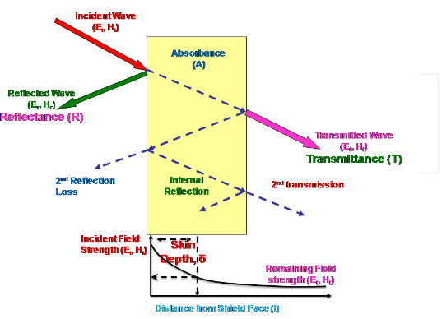
EM Considerations
Principal need: Range
Principal challenge: Conducting medium-
Transmission Coefficient
Skin Depth
Affects:
Source type
Main EM field
Operating Frequency

Slide 7
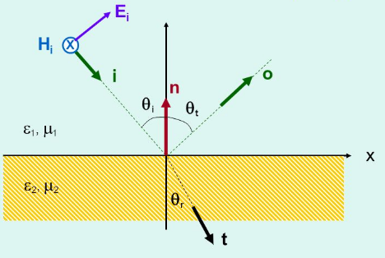
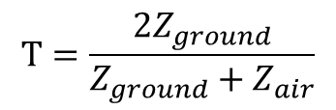


Transmission Coefficient
$$T=\frac{2Z_{ground}}{Z_{ground}+Z_{air}}$$
$$Z_{free space}=120π Ω= 377 Ω$$
$$Z_{ground}=\sqrt{\frac{j2πfμ}{σ+j2πfε}}$$

Slide 8
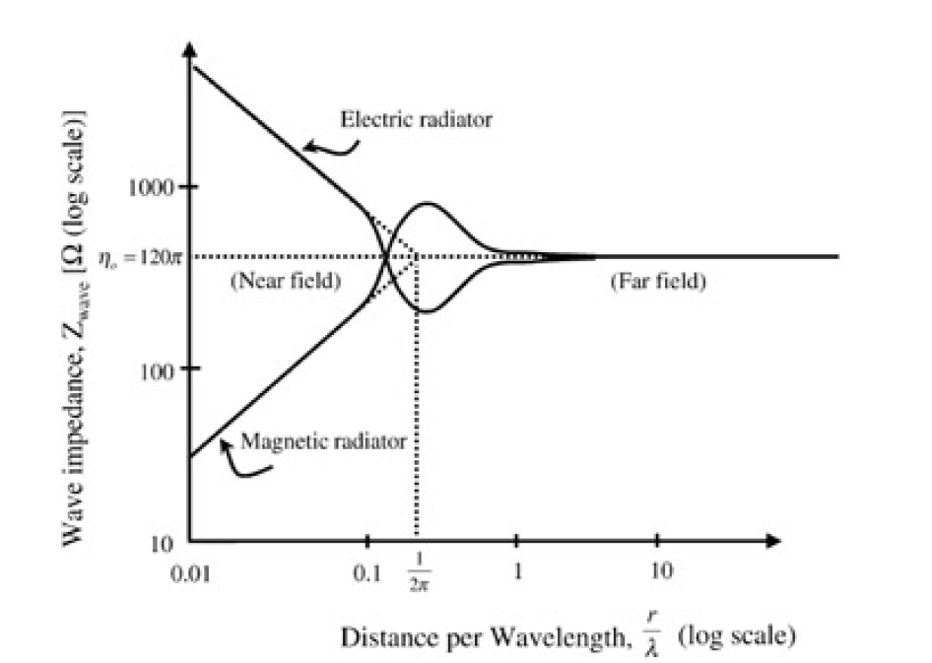
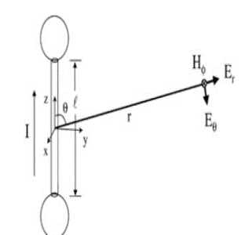
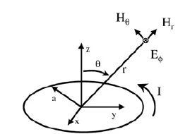
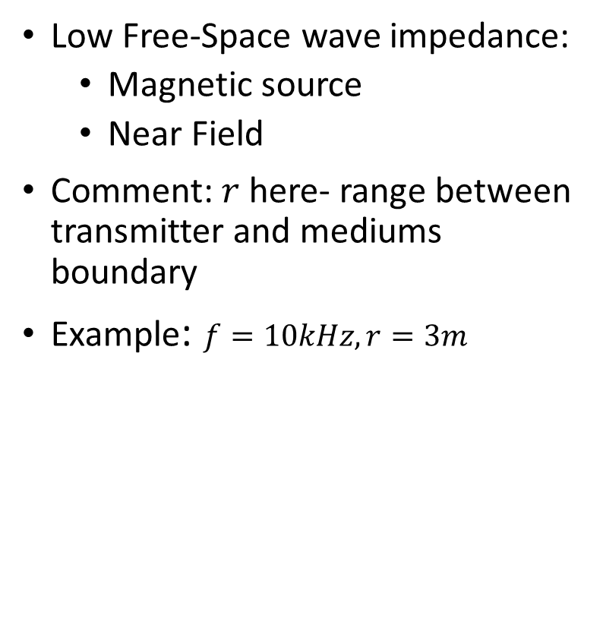

Magnetic Vs. Electric Source, the Near Field
Low Free-Space wave impedance:
Magnetic source
Near Field
Comment: $r$here- range between transmitter and mediums boundary
Example: $f=10kHz, r=3m$
$$f=10kHz\overset{→}{\begin{aligned}free \\ space\end{aligned}}λ=30km$$
$$\frac{r}{λ}=0.001$$
$$→Z_{free−space}\sim 10Ω$$
$$⇒T=−15.5dB$$

Slide 9

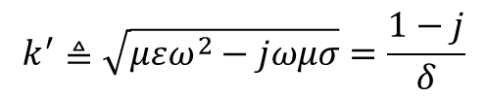

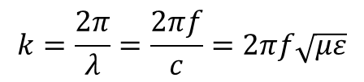

Magnetic Source EM Fields expressions
Magnetic induction from magnetic vector potential
Wave equation
Wave number
Permeability in a conducting medium
Wave number in a conducting medium
$$\vec{H}=\frac{1}{μ}\vec{∇}x\vec{A}$$
$$\left(∇^{2}−k^{2}\right)\vec{A}=−μ\vec{J}$$
$$k=\frac{2π}{λ}=\frac{2πf}{c}=2πf\sqrt{με}$$
$$ε^{′}≜ε−j\frac{σ}{ε}$$
$$k^{′}≜\sqrt{μεω^{2}−jωμσ}=\frac{1−j}{δ}$$

Slide 10
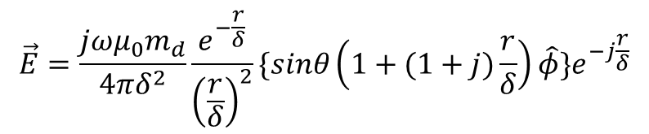
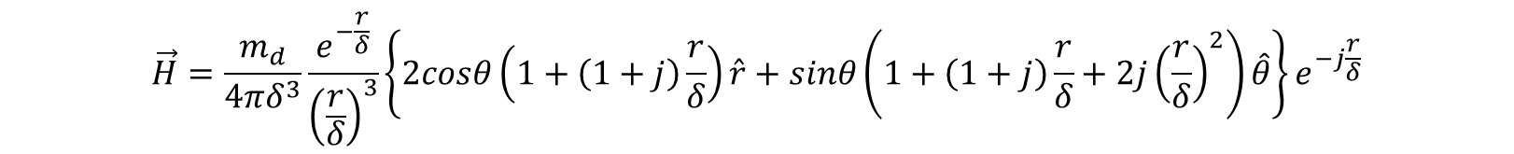
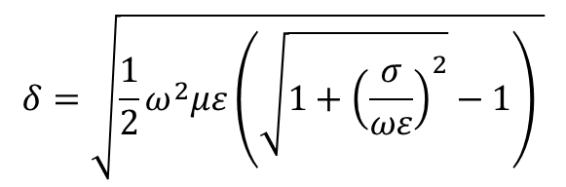
Magnetic Source EM Fields expressions
Magnetic Field
Electric Field
Skin depth:
$$\vec{H}=\frac{m_{d}}{4πδ^{3}}\frac{e^{−\frac{r}{δ}}}{{\left(\frac{r}{δ}\right)}^{3}}\left\{2cosθ\left(1+\left(1+j\right)\frac{r}{δ}\right)\hat{r}+sinθ\left(1+\left(1+j\right)\frac{r}{δ}+2j{\left(\frac{r}{δ}\right)}^{2}\right)\hat{θ}\right\}e^{−j\frac{r}{δ}}$$
$$\vec{E}=\frac{{jωμ_{0}m}_{d}}{4πδ^{2}}\frac{e^{−\frac{r}{δ}}}{{\left(\frac{r}{δ}\right)}^{2}}\{sinθ\left(1+(1+j)\frac{r}{δ}\right)\hat{φ}\}e^{−j\frac{r}{δ}}$$
$$δ=\sqrt{\frac{1}{2}ω^{2}με\left(\sqrt{1+{\left(\frac{σ}{ωε}\right)}^{2}}−1\right) }$$

Slide 11
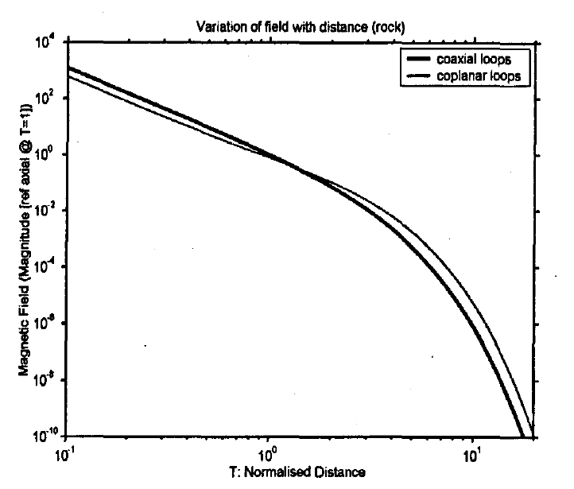




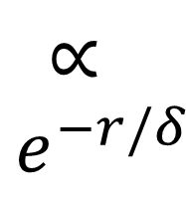
Fields within conducting medium: the Skin Effect
$${∝\left(r/δ\right)}^{3}$$
$$∝$$
$$e^{−r/δ}$$
Quasi
Static
zone
Far Field
zone
Near Field zone
$$r\sim 0.1δ$$
$$r\sim 10δ$$
$$T=\frac{r}{δ}$$

Slide 12
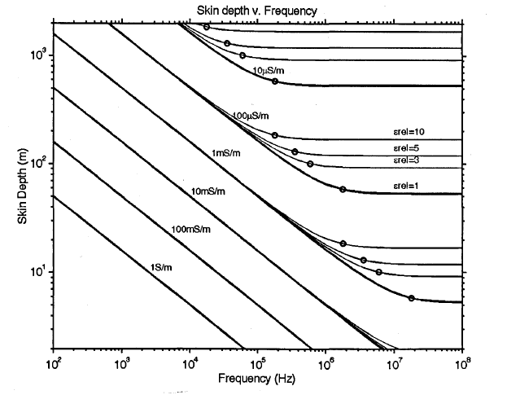


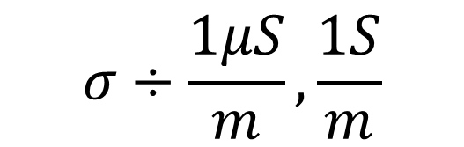
Fields within conducting medium: the Skin Effect
$$ε_{r}÷7,43$$
$$σ÷\frac{1μS}{m},\frac{1S}{m}$$
$$f=10kHz→δ\sim 100m$$

Slide 13
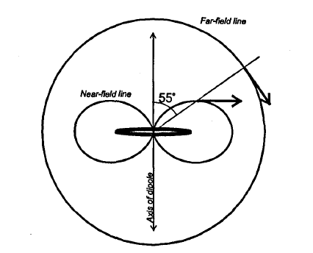
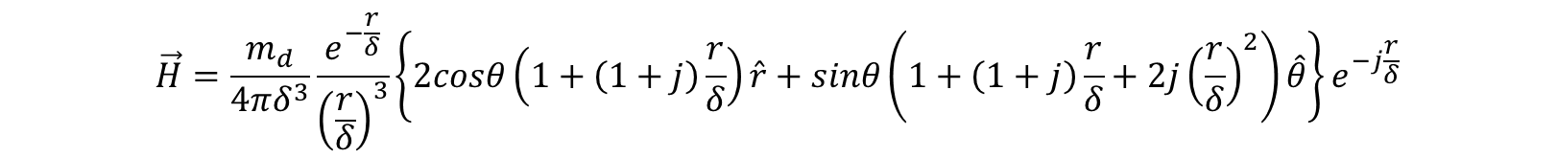
Antennas: Near/Far Field lines
$$\vec{H}=\frac{m_{d}}{4πδ^{3}}\frac{e^{−\frac{r}{δ}}}{{\left(\frac{r}{δ}\right)}^{3}}\left\{2cosθ\left(1+\left(1+j\right)\frac{r}{δ}\right)\hat{r}+sinθ\left(1+\left(1+j\right)\frac{r}{δ}+2j{\left(\frac{r}{δ}\right)}^{2}\right)\hat{θ}\right\}e^{−j\frac{r}{δ}}$$

Slide 14
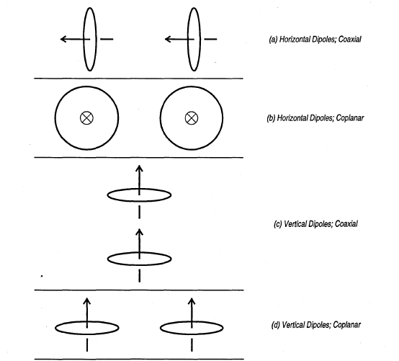
Antennas: Mutual Orientation

Slide 15
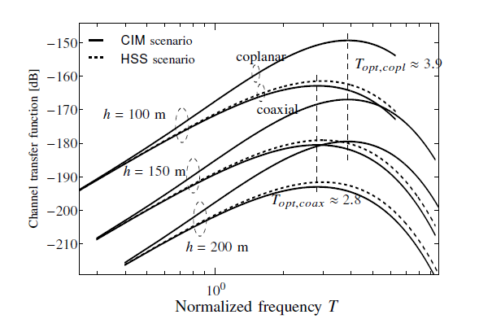
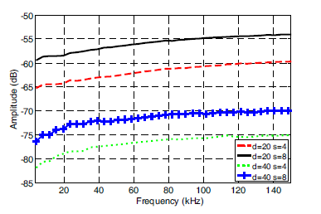
Selectivity: VLF channel

Slide 16
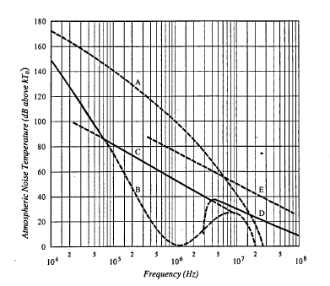
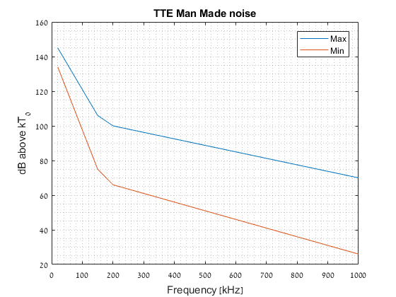
Selectivity: VLF Noise

Slide 17
Technique choice: Considerations
Channel & Noise Models:
Unreliable
Out of date (man made noise)
Certainty: frequency selective!
Literature & Commercial system:
Analog modulations
Digital single carrier modulations
Fixed stations: channel, mutual antenna orientation and noise well known
Poor performance
Our needs: Deployable moving stations-
Variable antennas orientation
Variable channel
Variable noise

Slide 18
OFDM- A preferred communication technique

Slide 19
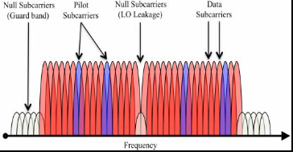
OFDM in the TTE context
Selective& Dynamic Channel:
Easy equalization
Easy adaptation to varying length channels
Possibly frequency selective power, modulation and coding
Selective noise:
Possibly frequency selective power, modulation and coding
Dynamic Antenna orientation:
OFDM& MIMO MRC

Slide 20
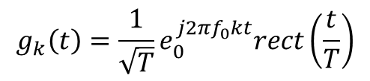
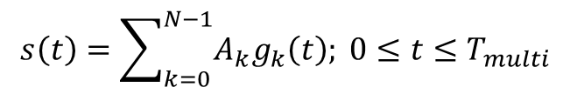



OFDM Transmission
Transmitted signal:
Kernel
Digital realization:
$$s\left(t\right)=\sum_{k=0}^{N−1}{A_{k}g_{k}\left(t\right); 0≤t≤T_{multi}}$$
$$g_{k}\left(t\right)=\frac{1}{\sqrt{T}}e_{0}^{j2πf_{0}kt}rect\left(\frac{t}{T}\right)$$
$$t=nT_{s}, T=N_{FFT}T_{s}$$
$$s\left(n\right)=\frac{1}{\sqrt{N_{FFT}}}\sum_{k=0}^{N_{FFT}−1}{A_{k}e^{\frac{j2πnT_{s}}{N_{FFT}T_{s }}}}rect\left(\frac{nT_{s}}{N_{FFT}T_{s}}\right)=\frac{1}{\sqrt{N}}\sum_{k=0}^{N_{FFT}−1}{A_{k}e^{\frac{j2πn}{N_{FFT}}}}rect\left(\frac{n}{N_{FFT}}\right)=\frac{1}{\sqrt{N_{FFT}}}\sum_{k=0}^{N−1}{A_{k}e^{\frac{j2πn}{N_{FFT}}}}; 0≤n≤N_{FFT}−1$$
$$⇒s\left(n\right)=IDFT{\left\{A_{k}\right\}}_{n}$$

Slide 21
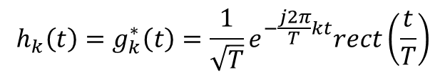
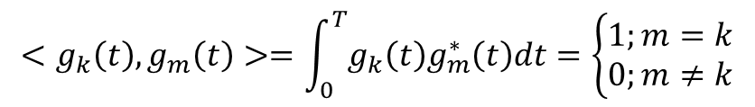

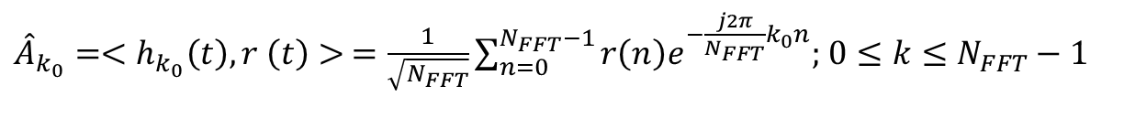
OFDM Reception
Kernel Orthonormality:
Matched Filtering:
Digital realization:
$$<g_{k}\left(t\right),g_{m}\left(t\right)>=\int_{0}^{T}{g_{k}\left(t\right)g_{m}^{∗}\left(t\right)dt}=\left\{\begin{aligned}&1;m=k \\ &0;m≠k\end{aligned}\right.$$
$$h_{k}\left(t\right)=g_{k}^{∗}\left(t\right)=\frac{1}{\sqrt{T}}e^{−\frac{j2π}{T}kt}rect\left(\frac{t}{T}\right)$$
${\hat{A}}_{k_{0}}=<h_{k_{0}}\left(t\right),r \left(t\right)> =\frac{1}{\sqrt{N_{FFT}}}\sum_{n=0}^{N_{FFT}−1}{r\left(n\right)e^{−\frac{j2π}{N_{FFT}}k_{0}n};}$ $0≤k≤N_{FFT}−1$
$${\hat{A}}_{k_{0}}=DFT{\left\{r\left(n\right)\right\}}_{k_{0}}$$

Slide 22
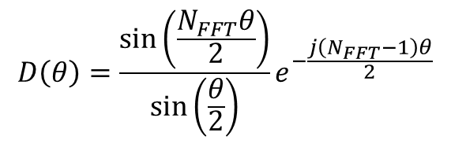
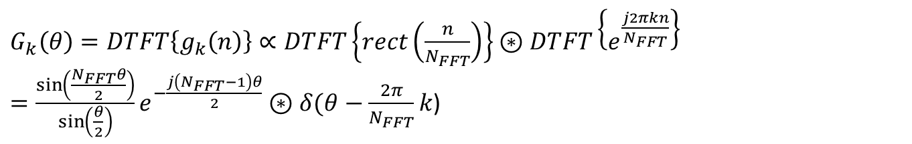

OFDM: Frequency Domain
Fourier Transform of the kernel
Dirichlet Kernel:
$G_{k}\left(θ\right)=DTFT\left\{g_{k}\left(n\right)\right\}∝DTFT\left\{rect\left(\frac{n}{N_{FFT}}\right)\right\}⊛DTFT\left\{e^{\frac{j2πkn}{N_{FFT}}}\right\}=\frac{\sin\left(\frac{N_{FFT}θ}{2}\right)}{\sin\left(\frac{θ}{2}\right)}e^{−\frac{j\left(N_{FFT}−1\right)θ}{2}}⊛δ(θ−\frac{2π}{N_{FFT}}k$)
$$D\left(θ\right)=\frac{\sin\left(\frac{N_{FFT}θ}{2}\right)}{\sin\left(\frac{θ}{2}\right)}e^{−\frac{j\left(N_{FFT}−1\right)θ}{2}}$$
$${⇒G}_{k}\left(θ\right)=D(θ−θ_{k})$$

Slide 23
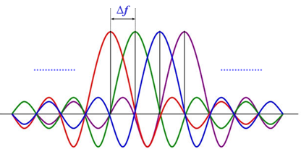
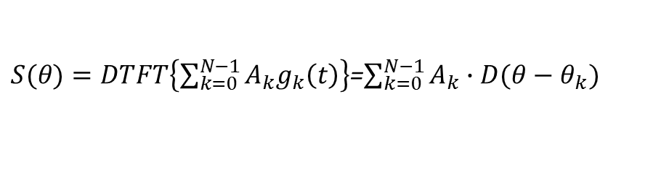

OFDM: Frequency Domain
Single Kernel spectrum
Whole signal spectrum:
$${⇒G}_{k}\left(θ\right)=D(θ−θ_{k})$$
$S(θ)=DTFT\left\{\sum_{k=0}^{N−1}{A_{k}g_{k}\left(t\right)}\right\}$=$\sum_{k=0}^{N−1}{A_{k}∙D(θ−θ_{k})}$

Slide 24
OFDM: frequency domain- special subcarriers
1)Channel est.
2) Freq synch
1)DSP alleviation
2) ACPR prevention

